Slide 1

Bank Management Application Project Presentation
This presentation outlines a Frontend project report on developing a bank management application. The application aims to streamline banking operations by providing services to customers, employees, and administrators.
Suyash S.Raskar
Utkarsh S. Thorat
Pruthviraj B. Jagtap
Himanshu S. Londhe
Trainer Name : Miss. Monica Jadhav.
PJ
PJ
by P J

Slide 2
Frontend ReactJS Bank Management Web Application Introduction.
This presentation introduces a new frontend bank management web application built using ReactJS, a leading JavaScript framework, along with a suite of supporting technologies to provide a robust and user-friendly banking platform. The application leverages HTML, CSS, and JavaScript for core functionality, complemented by Bootstrap and React libraries (such as Material-UI or Ant Design) to enhance the user interface and streamline development.

Slide 3
Frontend ReactJS Bank Management Web Application: An Abstract
User-Friendly Interface
Secure Transactions
Streamlined Operations
Intuitive design for seamless navigation and ease of use.
Robust security measures to protect sensitive data and prevent unauthorized access.
Efficient workflows for faster transaction processing and improved operational efficiency.
Modern Technology Stack
Enhanced Customer Experience
ReactJS, Bootstrap, and other modern technologies ensure scalability and maintainability.
Improved customer satisfaction through a user-friendly and efficient platform.

Slide 4
Project Overview
Customer Module
Employee Module
Admin Module
Allows customers to view account balances, transaction history, and transfer funds.
Provides employees with tools to manage accounts, process transactions, and handle customer inquiries.
Offers administrators the ability to manage users, accounts, and system settings.

Slide 5




Project Objectives
Streamline Banking Operations
Enhance User Experience
Develop a user-friendly and intuitive interface.
Provide efficient services to customers and employees.
Secure Transactions
Implement robust security measures to protect sensitive data.

Slide 6
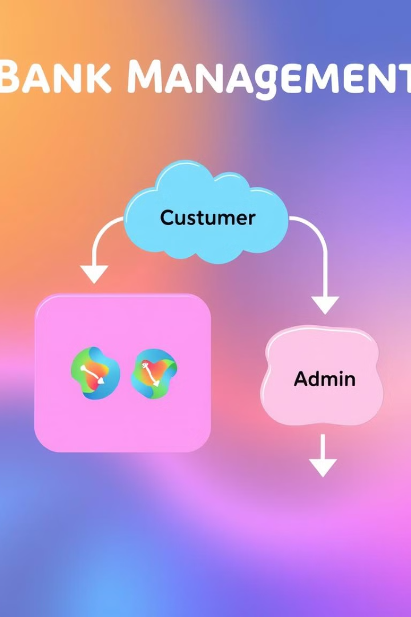
Website Modules
Customer Module
Employee Module
View account balances, transaction history, transfer funds, and update personal information.
Manage accounts, process transactions, handle customer inquiries, and generate reports.
Admin Module
Manage users, accounts, system settings, and monitor system performance.

Slide 7
Data Flow Diagrams
Customer Module
1
Login/Registration, View Account Balance, View Transaction History, Transfer Funds, Update Profile.
2
Employee Module
Login, Manage Accounts, Process Transactions, Handle Customer Inquiries, Generate Reports.
Admin Module
3
Login, Manage Users, Manage Accounts, Manage System Settings, Monitor System Performance.
4
Account Management (All Modules)
Account Creation, Account Update, Account Deletion, Transaction Processing, Account Inquiry.
Transaction Processing (All Modules)
5
Transaction Initiation, Transaction Verification, Transaction Authorization, Transaction Recording, Transaction Reporting.
6
Security (All Modules)
Authentication, Authorization, Data Encryption, Access Control, Audit Trail.

Slide 8

Technology Stack
1
Frontend Technologies
2
JavaScript Framework
HTML, CSS, JavaScript
ReactJS
3
UI Library
4
Development Tools
Bootstrap, React Libraries (e.g., Material-UI, Ant Design)
Node.js, npm/yarn, package managers, etc.
5
Software Requirements
6
Hardware Requirements
Node.js, npm or yarn, a code editor (VS Code, Sublime Text, etc.), a web browser (Chrome, Firefox, etc.)
A computer with a reasonable processor, sufficient RAM (at least 8GB recommended), and enough storage space.

Slide 9





Project Benefits
Improved Customer Experience
1
User-friendly interface for seamless transactions.
2
Enhanced Security
Robust security measures to protect sensitive data.
3
Increased Operational Efficiency
Streamlined processes for faster transaction processing.
4
Reduced Operational Costs
Efficient resource management, reduced manual effort.
5
Scalability and Maintainability
Easily scalable architecture to accommodate growing user base.

Slide 10
ReactJS Development Details
Core Components and Concepts
State Management: React's state management is crucial for dynamic updates. Use useState to manage simple state, useReducer for complex state logic, and useContext for sharing state across components. useRef provides mutable values that don't trigger re-renders.
Hooks: Hooks like useEffect handle side effects (e.g., data fetching, subscriptions), allowing you to manage lifecycle events effectively. React Fragments (<React.Fragment>) allow returning multiple elements without adding extra DOM nodes.
JavaScript Fundamentals
Event Handling: React uses synthetic events. Attach event listeners using inline handlers (e.g., onClick={handleClick}) or using addEventListener. Event handling allows interactive components.
Conditionals: Use JavaScript's conditional statements (if, else if, else, ternary operator) to control rendering based on state or props.
React Libraries and Routing
React Router: For navigation, integrate React Router to manage different views and routes. React Router provides tools for declarative routing and handling URL changes.
External Libraries: Depending on project needs, incorporate libraries like Axios, Redux, or others to extend functionality. and other libraries like React-icons/Fa, React material lib.,etc.
Advanced Concepts
Refs: Direct DOM manipulation using useRef provides advanced control over elements (e.g., focus, scroll). Refs should be used sparingly to avoid interfering with React's reconciliation process.
Class Components: While functional components with hooks are now preferred, class components offer lifecycle methods (componentDidMount, componentWillUnmount, etc.) for managing side effects and state. They use this.state and this.setState() for state management. Class components provide a different approach to component structure and may be useful in certain situations or legacy codebases.

Slide 11
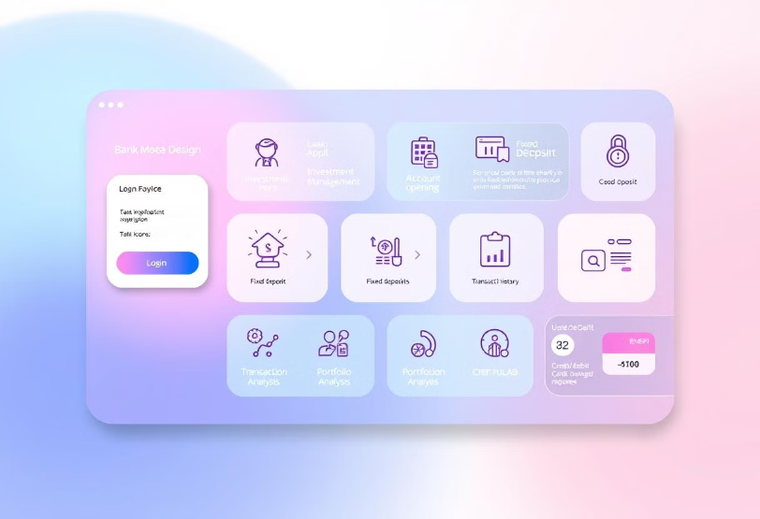
Bank Management Application Architecture
Key Features
Login/Authentication
Loan Application
Investment Management
Fixed Deposits
Account Opening (Personal, NRI, Business)
Transaction History
Portfolio Analysis
Credit/Debit/Visa Card Applications

Slide 12
Class Diagram
Login Class
Account Classes
Transaction & Finance Classes
Navigation & Application Classes
login(): Authenticates user credentials.
PersonalAccount:
Loan Class:
MainMenu: Manages main navigation links.
logout(): Terminates user session.
deposit()
applyLoan(): Submits a loan application.
AccountMenu: Manages account-specific navigation.
checkCredentials(): Verifies username and password.
withdraw()
calculateEMI(): Calculates loan EMI.
checkBalance()
checkLoanStatus(): Checks the status of a loan application.
TransactionMenu: Manages transaction-related navigation.
NRI Account:
deposit()
Investment Class:
Apply Button Class:
withdraw()
createInvestment(): Creates a new investment.
handleClick(): Triggers application submission.
checkBalance()
validateForm(): Checks form data for completeness.
reportForeignIncome()
viewPortfolio(): Views the investment portfolio.
BusinessAccount:
trackPerformance(): Tracks investment performance.
submitApplication(): Sends application data to server.
deposit()
withdraw()
Insurance Class:
checkBalance()
applyInsurance(): Applies for insurance.
generateReport()
viewPolicy(): View insurance policy details.
makePayment(): Makes an insurance payment.
Funds Class:
viewFunds(): View available funds.
transferFunds(): Transfers funds between accounts.

Slide 13
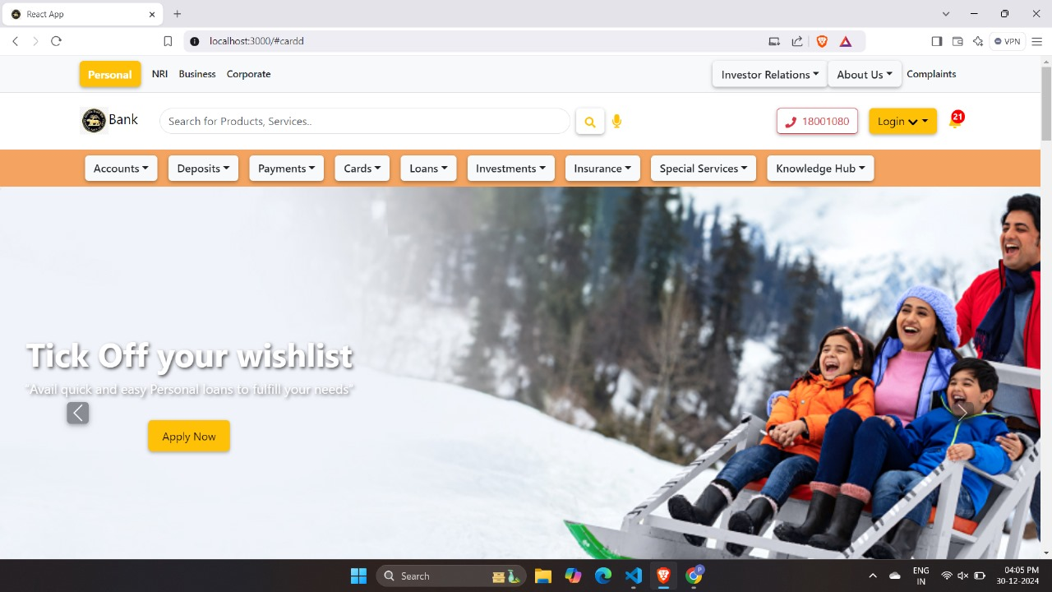
Output

Slide 14
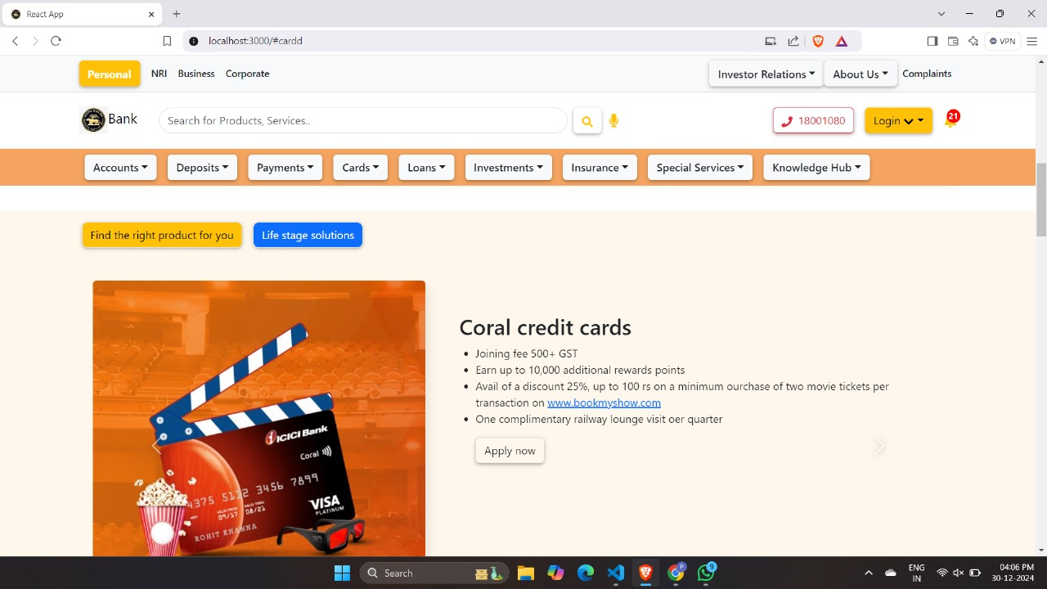
Output

Slide 15
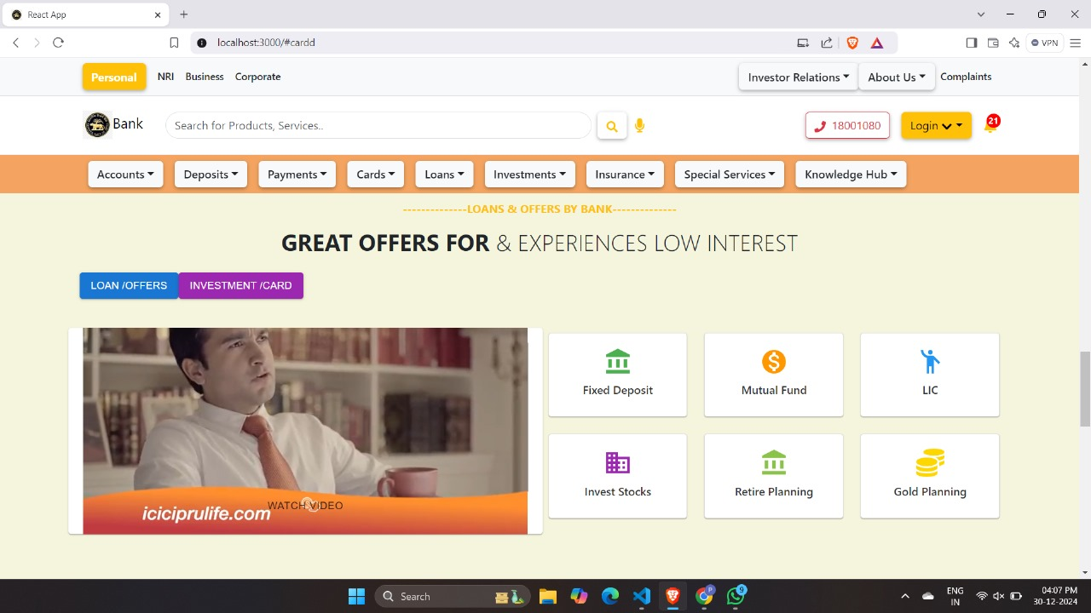
Output

Slide 16
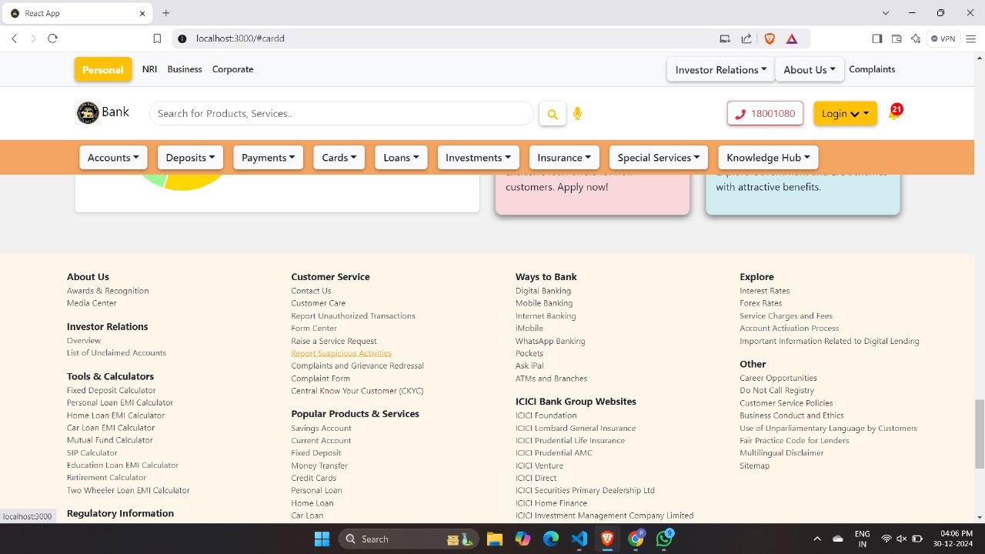
Output

Slide 17

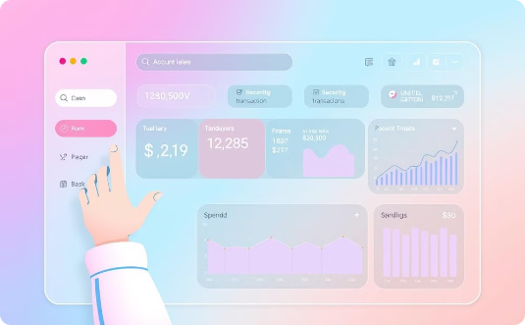
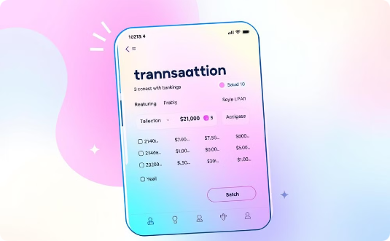
Useful Resources
ReactJS Code Example
Main Dashboard
Transaction Details

Slide 18

Conclusion
This frontend bank management web application provides a secure and user-friendly platform for managing bank accounts, processing transactions, and performing other essential banking operations. Developed with a focus on streamlined workflows and intuitive design, it aims to improve efficiency for both customers and bank employees. The application promises to enhance security, improve the customer experience, and ultimately increase overall operational efficiency for the bank.

Slide 19
Reference
ICICI Bank Website
For more information on ReactJS development, check out these resources:
Official ReactJS Website (Google)
For banking-related information:
Reserve Bank of India (RBI) Website
For Bootstrap 5 and JavaScript resources:
Bootstrap 5 Documentation
JavaScript.com
These links provide further learning and background information on the technologies and institutions involved in this project.

Slide 20

Thank You!
We appreciate your time and consideration. We look forward to collaborating further.

